Slide 1

Big Data Project – EEG-Based Emotion Detection using DEAP Dataset
Done and Presented by :
BENALI Ayoub
CHEBCHOUB Nouh Taha
Supervised by :
Prof. MOUAZEN Badr
Prof. ABDELWAHED El Hassan
2024 - 2025

Slide 2
Plan
Project Overview
Dataset Overview
Related Works
Methodology and Results
Discussion
Conclusion

Slide 3
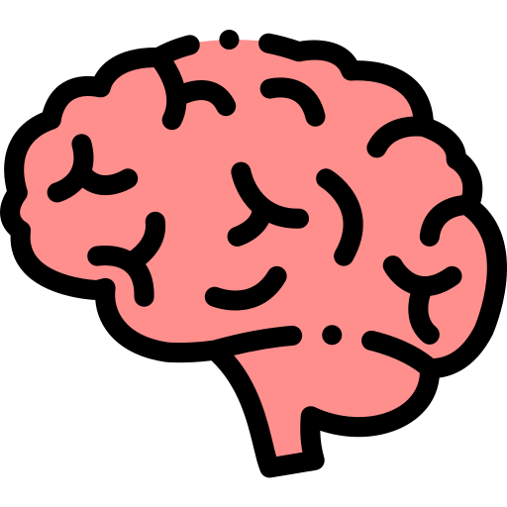


Project Overview
This project focuses on emotion detection using EEG signals, leveraging the DEAP dataset for its widespread recognition, robustness, and manageable size compared to larger datasets like Propane, which is approximately 150 GB and computationally demanding.
We have employed a variety of machine learning (ML) and deep learning (DL) techniques, which will be discussed in detail later in this presentation.
To enhance the interpretability of our emotion detection model, we integrated an Explainable AI (XAI) technique, specifically SHAP (SHapley Additive exPlanations), to identify which frequency bands most significantly influence the model's predictions.
As a highlight of our work, we developed a real-time emotion detection simulation capable of instantaneously identifying emotions. Our efforts have yielded highly promising results, demonstrating the effectiveness of our approach.

Slide 4
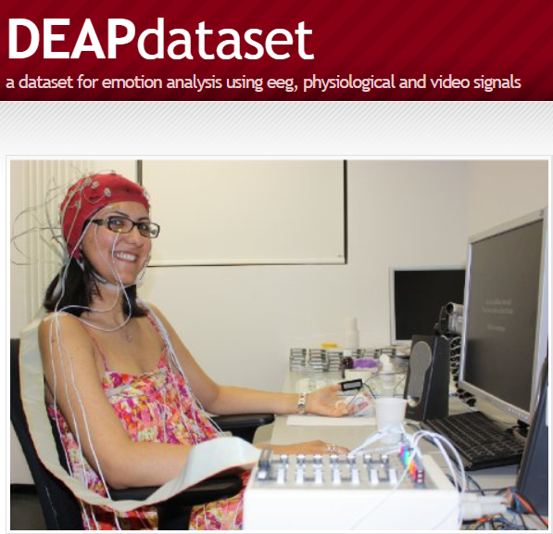
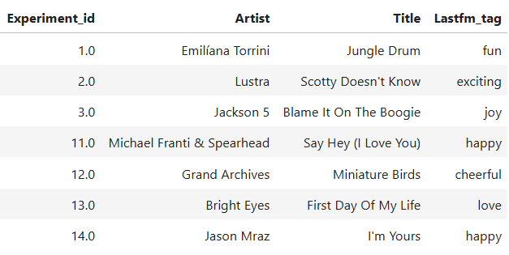
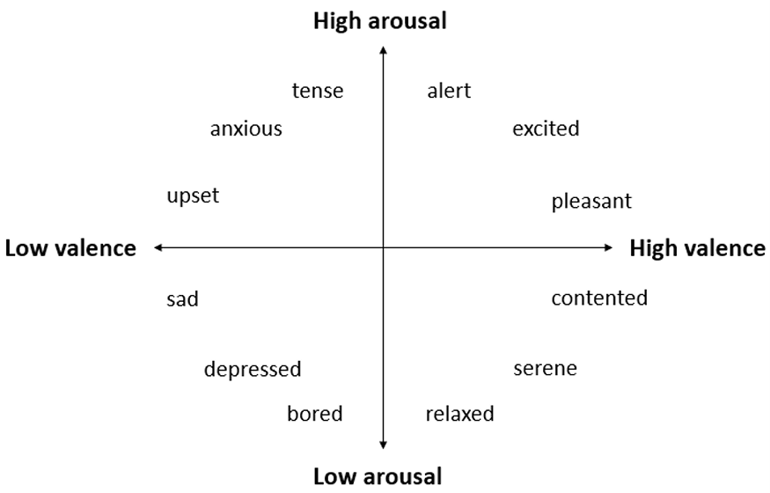
Dataset Overview
The DEAP (Database for Emotion Analysis using Physiological Signals) dataset includes data from 32 participants, each exposed to 40 trials of 60-second music videos as emotional stimuli.
EEG data was recorded at 128 Hz across 32 channels, capturing four emotional dimensions: valence, arousal, liking, and dominance.
For classification, valence and arousal were categorized into "high" or "low" groups using thresholds (e.g., >6.5 for high valence/arousal). This standardized approach ensured consistent evaluation of emotional responses while accounting for variability in stimulus order.

Slide 5
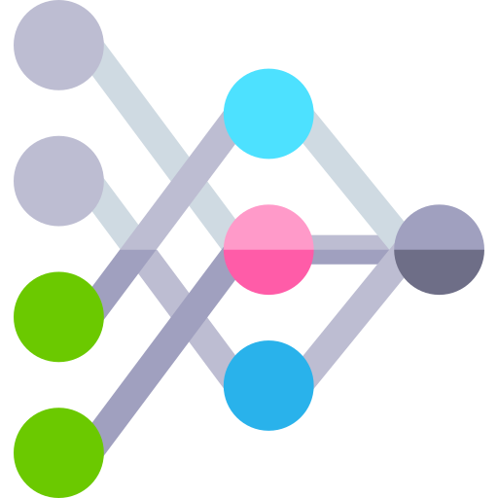
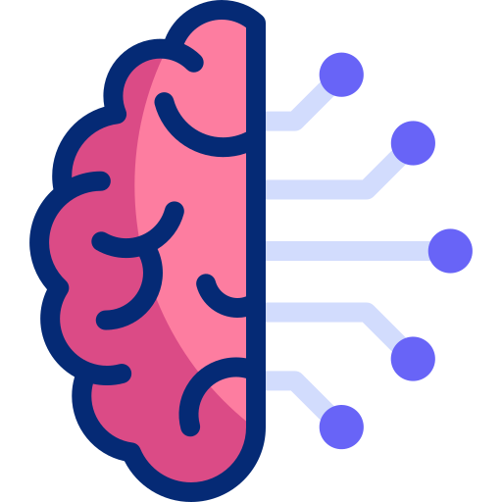
Related Works
Chen et al. (CNNs for emotion recognition)
Alhagry et al. (LSTMs for sequential EEG data)
This study used Convolutional Neural Networks (CNNs) to classify valence and arousal from EEG signals, achieving high accuracies of 85.57% for arousal and 88.76% for valence, demonstrating the effectiveness of CNNs in capturing spatial features for emotion recognition.
By employing Long Short-Term Memory (LSTM) networks, this work achieved accuracies of 85.65%, 85.45%, and 87.99% for valence, arousal, and liking, respectively, highlighting the importance of modeling temporal dependencies in EEG signals.
Li et al. (Hybrid CNN-LSTM approach)
Xing et al. (SAE-LSTM for subject-independent recognition)
-----------------------------------------------
This study combined CNNs for spatial feature extraction and LSTMs for temporal modeling, achieving 75.21% accuracy in classifying four emotional states, showcasing the benefits of integrating spatial and temporal analysis.
Using Sparse Autoencoders (SAE) for unsupervised feature learning and LSTMs for temporal analysis, this work achieved 81.10% and 74.38% accuracy for valence and arousal, respectively, emphasizing robustness in cross-subject emotion recognition.

Slide 6
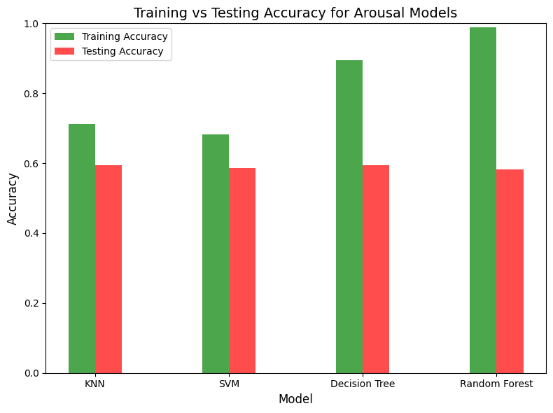
Methodology and Results
In our methodology, we initially explored the performance of classical machine learning algorithms for emotion detection from EEG signals. We implemented a simple architecture using K-Nearest Neighbors (KNN), Support Vector Machines (SVM), Decision Trees (DT), and Random Forests (RF).
Surprisingly, Decision Trees and Random Forests achieved remarkable training accuracy of 99%, but their testing accuracy dropped significantly to around 50%, indicating severe overfitting.
On the other hand, SVM and KNN delivered mediocre results, with both training and testing accuracies hovering around 60%.
These outcomes highlighted the limitations of classical approaches and underscored the need for more advanced deep learning architectures to improve generalization and performance.

Slide 7

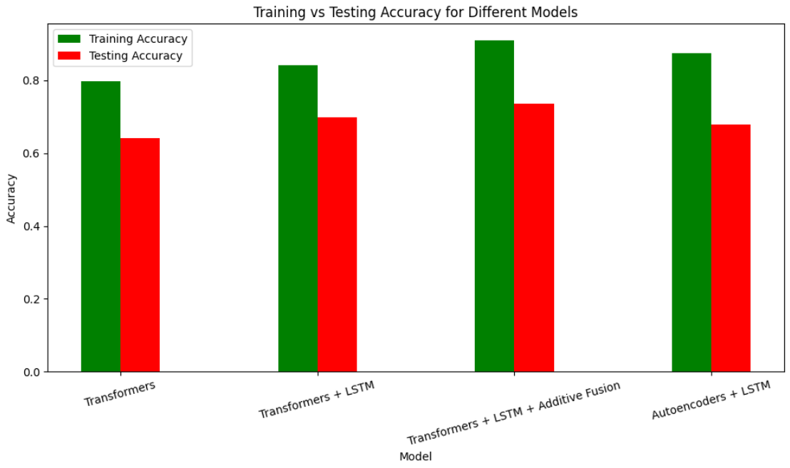
Methodology and Results
For our second implementation, we searched for a better architecture that could give us good results.
We came across a GitHub repository where someone had used Autoencoders, so we took their code, modified it to fit our needs, and achieved better results than they did.
However, we didn’t stop there. We tried using the Transformer architecture, but it only gave us around 70% accuracy, which wasn’t impressive.
To improve it, we combined the Transformer with LSTM, which increased the accuracy a bit. Still not satisfied, we added additive fusion, which pushed the accuracy close to 80%.
While this was a good improvement, we knew some other studies had achieved higher results, so we kept looking for a better architecture to detect emotions more accurately.

Slide 8
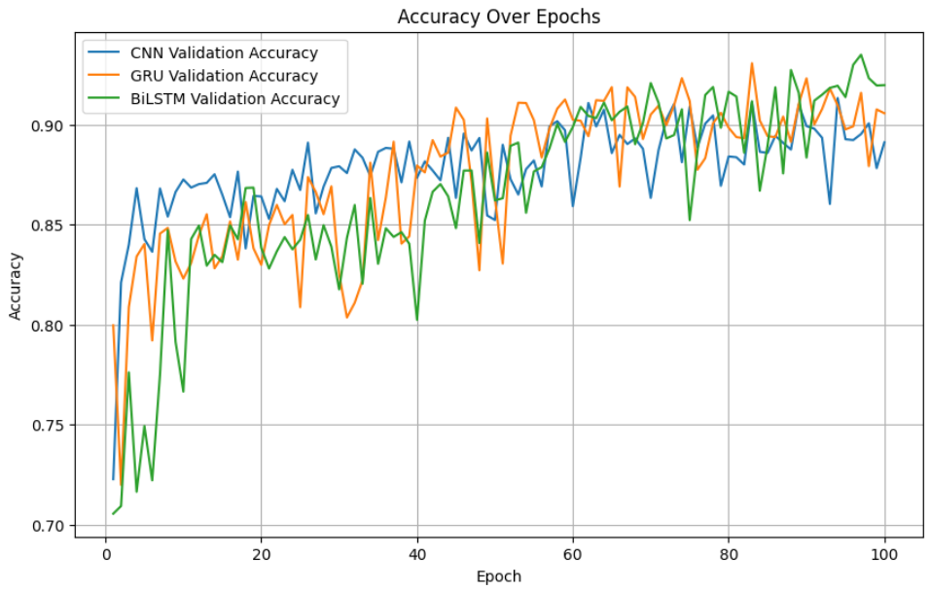
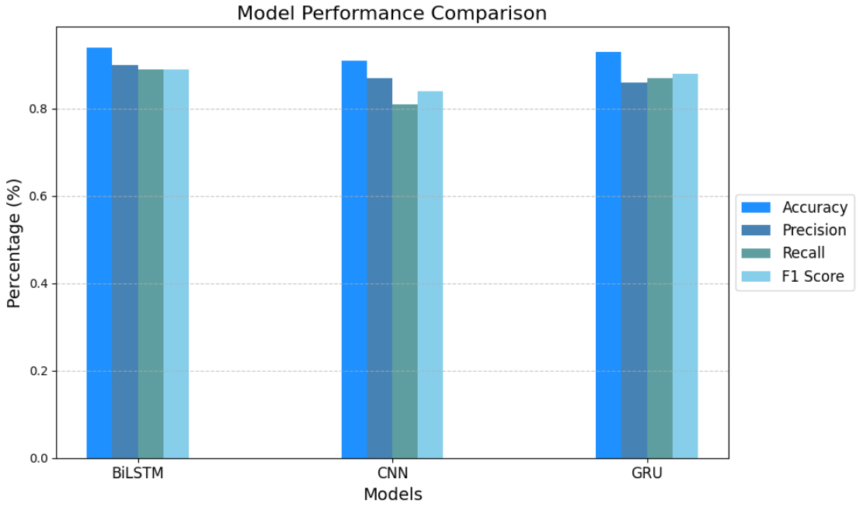
Methodology and Results
For our final implementation, after testing various architectures, we decided to explore CNN, BI-LSTM, and GRU, which are well-suited for sequential data like EEG signals.
Given that signals are inherently sequential, we believed these architectures would be effective for emotion detection.
After training the models, we achieved excellent results, with each model surpassing 90% accuracy. This indicates that the models can detect emotions with high precision. The best-performing model was the Bi-LSTM, which achieved an impressive 93% accuracy.

Slide 9
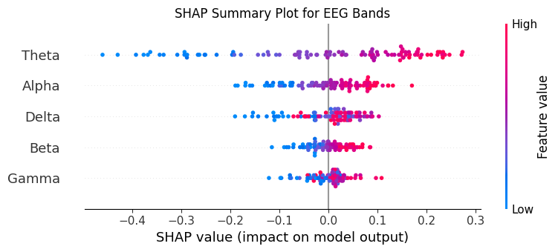
Methodology and Results
Now that we have our best model for detecting emotions with high accuracy, we wanted to understand how it makes its predictions.
To add a layer of explainability, we used SHAP (SHapley Additive exPlanations) to identify which frequency bands had the most influence on the model's decisions. This helped us gain insights into the key features driving the predictions.

Slide 10
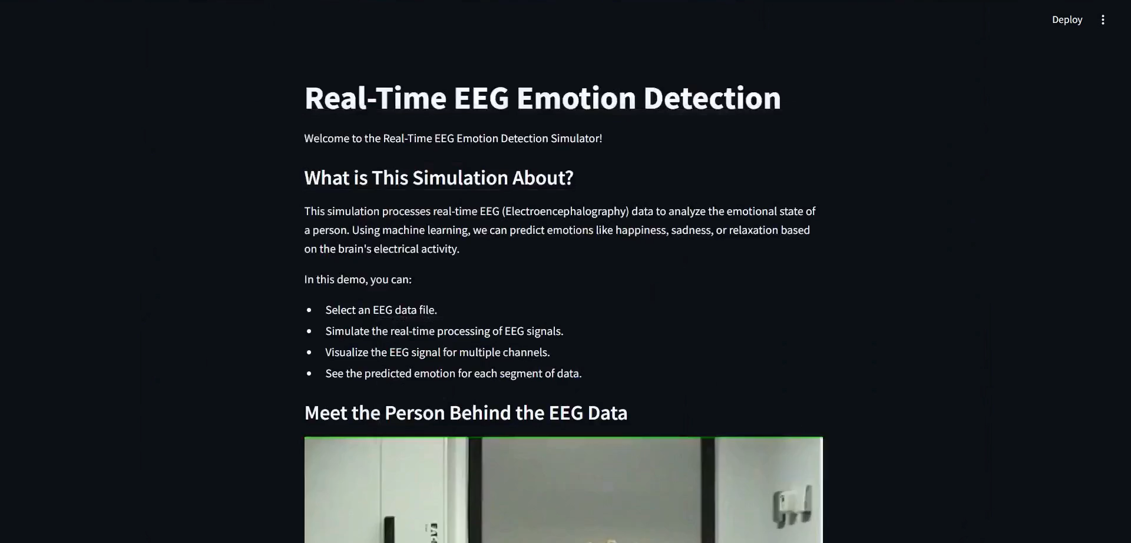
Methodology and Results

Slide 11
Discussion
Throughout the project, we conducted a comprehensive benchmarking of various implementations, with the Bi-LSTM emerging as the best-performing model.
The incorporation of explainability added a layer of clarity, revealing that the theta and alpha bands play a significant role in emotion detection, contributing the most to the model's predictions.
Additionally, the real-time simulation effectively demonstrated how emotions can be detected from EEG signals, providing a tangible representation of the model's capabilities.
However, like any project, our work has its strengths and weaknesses:
Strenghts :
Scalability Potential: The framework developed for emotion detection could be adapted or extended to other applications, such as mental health monitoring, brain-computer interfaces, or personalized user experiences.
User-Friendly Real-Time Simulation: The real-time simulation not only demonstrates the model's capabilities but also makes the technology accessible to non-technical stakeholders, such as clinicians or end-users.
Interdisciplinary Impact: The project bridges the gap between machine learning and neuroscience, fostering collaboration across disciplines and opening doors for future interdisciplinary research.

Slide 12
Discussion
Throughout the project, we conducted a comprehensive benchmarking of various implementations, with the Bi-LSTM emerging as the best-performing model.
The incorporation of explainability added a layer of clarity, revealing that the theta and alpha bands play a significant role in emotion detection, contributing the most to the model's predictions.
Additionally, the real-time simulation effectively demonstrated how emotions can be detected from EEG signals, providing a tangible representation of the model's capabilities.
However, like any project, our work has its strengths and weaknesses:
Weaknesses :
Limited Generalization: The model's performance may be constrained by the specific dataset used, potentially limiting its generalizability to other datasets or real-world scenarios.
Sensitivity to Noise: EEG signals are prone to noise from muscle movements, environmental interference, or equipment artifacts, which could degrade the model's performance and reliability.
Computational Complexity: Bi-LSTM models can be computationally intensive, which may pose challenges for real-time applications or deployment on resource-constrained devices.

Slide 13
Conclusion
In conclusion, this project demonstrates the potential of deep learning for EEG-based emotion classification, with our future work focusing on refining models, integrating multimodal signals, and improving interpretability. These advancements aim to enhance accuracy and enable real-time applications in neurofeedback and mental health monitoring.
We sincerely thank Professor ABDELWAHED for this enriching project and Professor Badr for his invaluable guidance and support. This experience has deepened our understanding of neuroscience, and we are truly grateful for your contributions to our learning journey.

Slide 14
Thank you for your attention

